Slide 1
Communicating HAI Information to Frontline Staff

Slide 2
Objective
The objective of this presentation is to provide guidance to those responsible for sharing hospital-associated infection information with frontline staff to maximize the impact of these communication efforts on the successful implementation of infection prevention practices.

Slide 3
Background for resource module
Effective communication of information about HAIs can engage frontline staff in infection prevention
Yet not all HAI information is useful for frontline staff
Focusing on HAI metrics and measures that are meaningful to this audience is important

Slide 4
Supporting discussion
Use the Assessment Form and Needs Assessment Form in coordination with this presentation to support discussion about current strategies of communicating information to frontline staff and future strategies to implement changes that can improve communication.

Slide 5
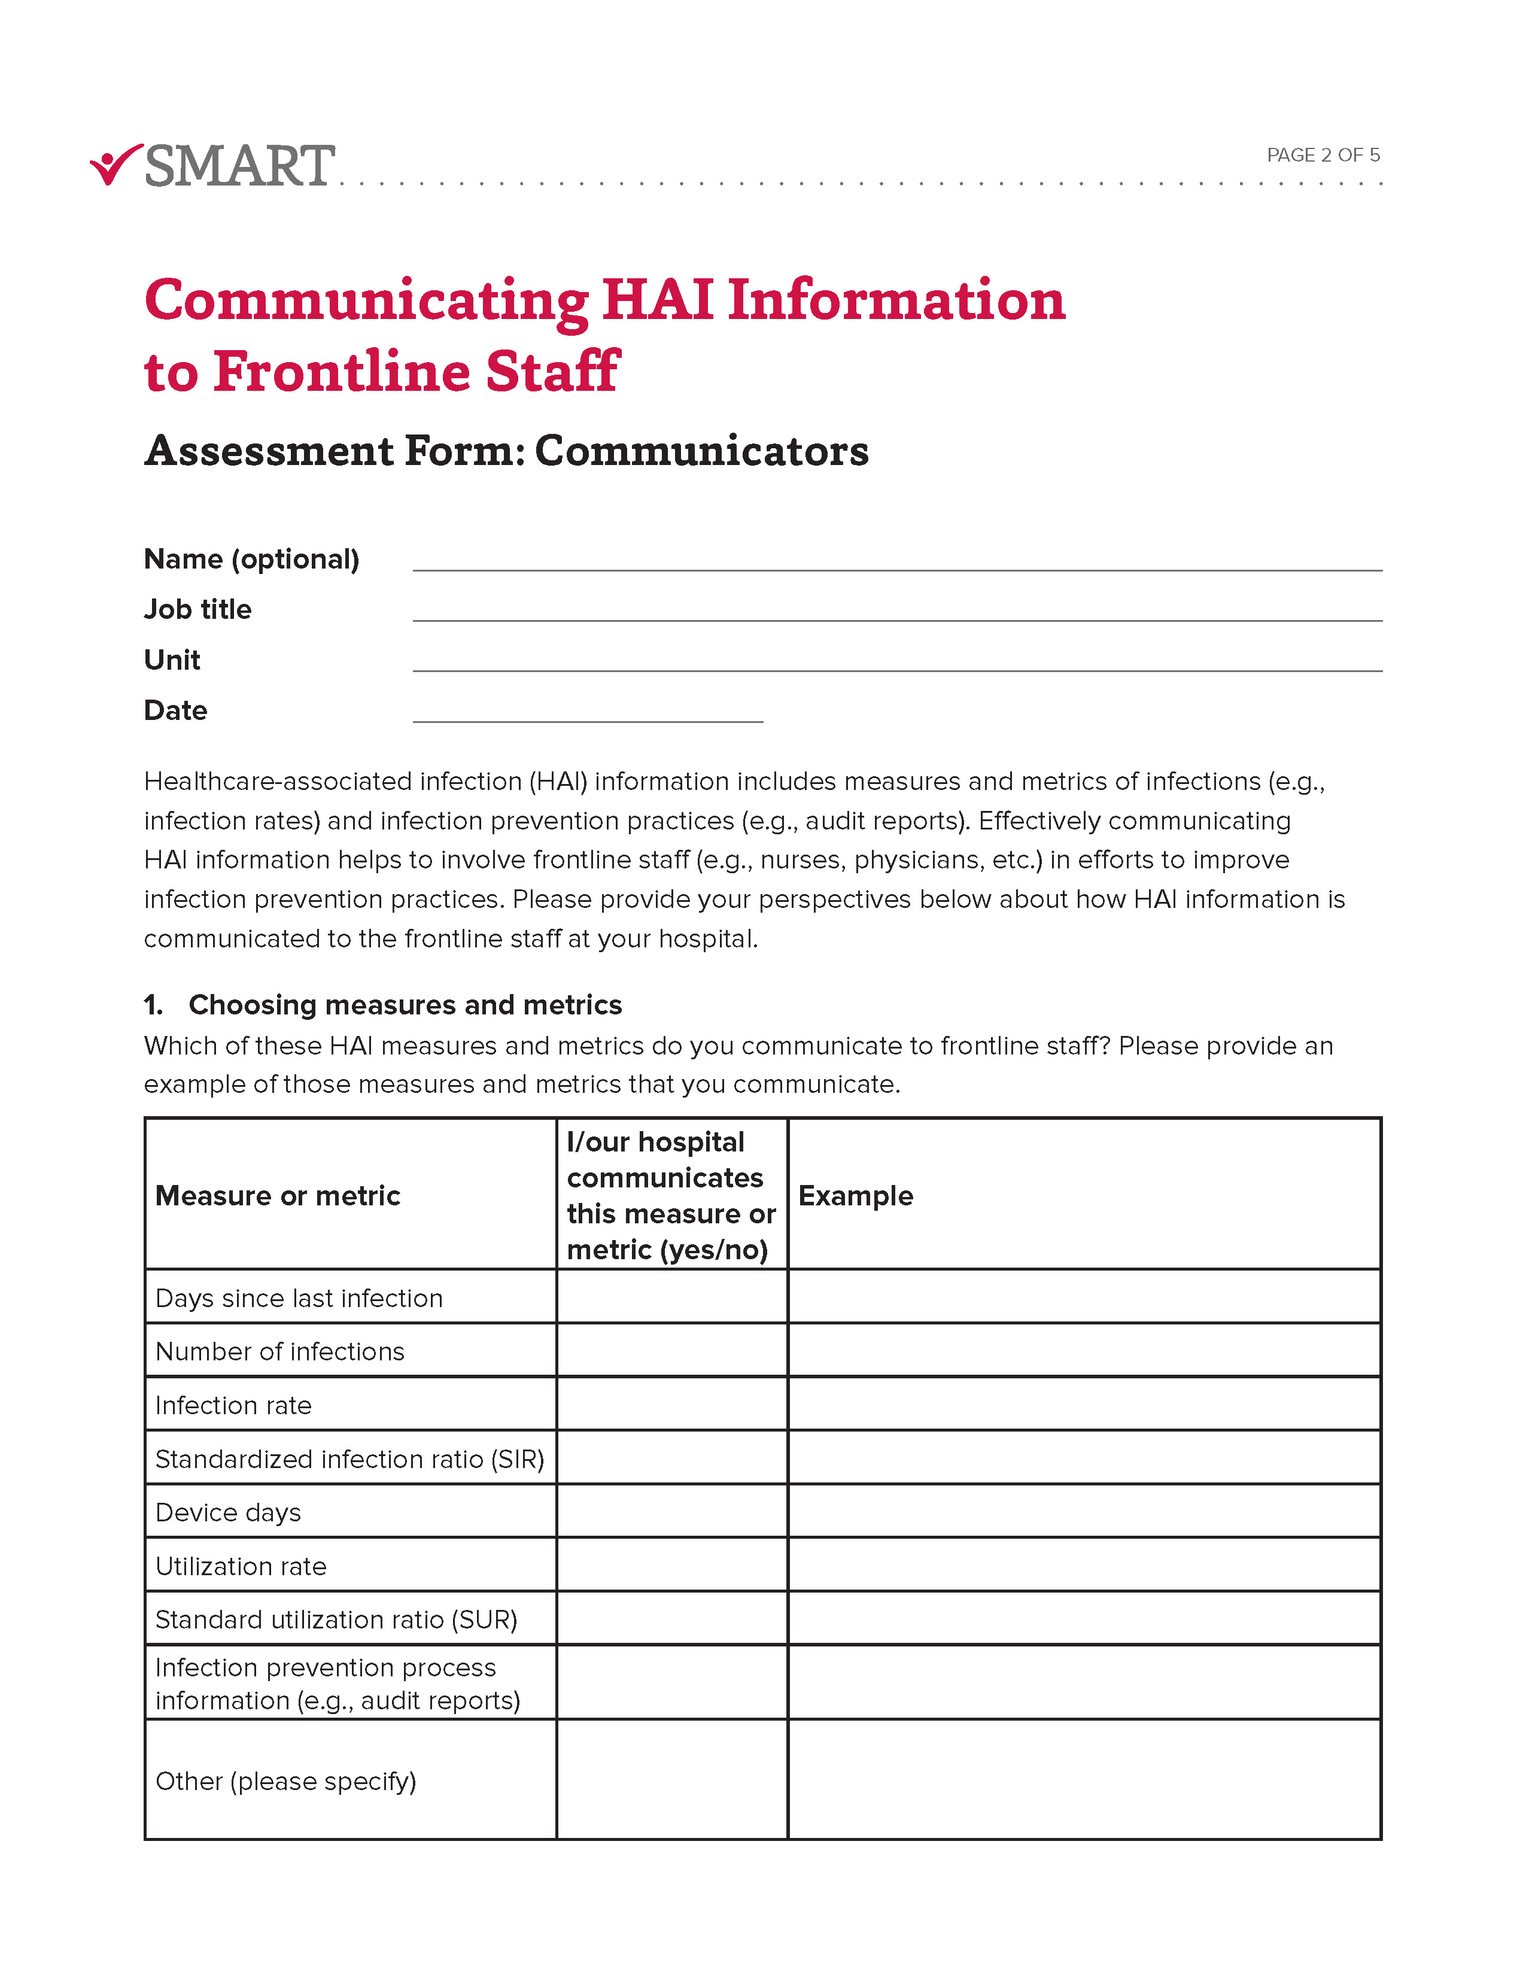
Assessment Form
Take a moment to complete the Assessment Form for communicators (e.g., those responsible for communicating HAI information to frontline staff, such as Frontline Managers, Infection Preventionists, etc.) to help you reflect on how you currently communicate HAI information to frontline staff.
The Assessment Forms filled out by your frontline staff will also provide insight on how HAI information is currently communicated in your hospital or unit.

Slide 6
Needs Assessment Worksheet
Throughout the presentation, please use the Needs Assessment Worksheet to reflect on ways in which communicating HAI information to frontline staff could be improved at your hospital.

Slide 7
Improving communication of HAI information to frontline staff
Choosing measures and metrics
Selecting ways to communicate HAI information
Determining the frequency and timing of
communicating HAI information
Maximizing the impact of communicating HAI information

Slide 8
Choosing measures and metrics

Slide 9
Common measures and metrics
HAIs, and the infection prevention processes used to prevent them, can be measured and tracked in many ways.
Common measures and metrics include:
Days since last infection
Number of infections
Infection rate
Standardized infection ratio (SIR)
Device days
Utilization rate
Standardized utilization ratio (SUR)
Infection prevention process information (audit reports, number of Foley catheters removed with a nurse-driven protocol, etc.)

Slide 10

Days since last infection
78 Days
“It has been 78 days since the last central line-associated bloodstream infection (CLABSI).”
This type of measure can be linked to a motivational goal.
Example: “The unit will celebrate together if it reaches 100 days without a CLABSI.”

Slide 11
Number of infections
16 Infections
“There have been 16 catheter-associated urinary tract infections (CAUTIs) in this ICU this year.”
This measure can be used to keep staff aware of new infections as well as provide a reference to infection prevention goals.
Example: “The unit needs to have fewer than 20 CAUTIs this year to meet its goal of improving from last year.”

Slide 12
Infection rate
3
Infections/1,000 Catheter Days
“The catheter-associated urinary tract infection (CAUTI) rate is three infections per 1,000 catheter days.”
This metric provides information that is standardized to device use to allow comparison between units.
Rationale: A unit that uses catheters rarely can compare their success with infection prevention to a unit that uses catheters frequently.

Slide 13
Standardized infection ratio (SIR)
1.35
“The central line-associated bloodstream infection (CLABSI) standardized infection ratio (SIR) is 1.35.”
This metric provides information that is standardized to allow comparisons among hospitals.
Rationale: A hospital can tell if it is doing worse than, better than, or no differently from its peers in terms of infections.

Slide 14

Device days
“We’ve had 100 Foley catheter days in the ICU this month.”
This measure provides information on device usage.
Rationale: A unit can recognize if its device use is increasing or decreasing.

Slide 15

Utilization rate
“The Foley catheter utilization rate is 200 Foley catheter days per 1,000 patient days.”
This measure provides information on device usage, normalized by number of patients.
Rationale: A unit can recognize if its catheter use is decreasing due to lower utilization or lower patient volume.

Slide 16

Standardized utilization ratio (SUR)
“The urinary catheter standardized utilization rate (SUR) is 0.85.”
This metric provides information that is standardized to allow comparisons among hospitals.
Rationale: A hospital can tell if it is doing worse than, better than, or no differently from its peers in terms of device utilization.

Slide 17

Infection prevention process information
“There was 80% compliance with central line dressing changes.”
This type of information provides feedback on adherence to standards in infection prevention practices.
Rationale: A unit can identify the level of compliance with recommended infection prevention practices to identify areas for improvement.

Slide 18
Making measures and metrics meaningful and motivational
When considering which measures and metrics to share with your frontline staff, the most meaningful and motivational are those that:
Link measures or metrics to goals
Report measures or metrics over time
Provide measures or metrics specific to the unit and individual
Personalize metrics and measures by associating them with patient information
Share information about prevention efforts, not just infection outcomes

Slide 19
Link measures or metrics to goals
Major prevention goals should be linked to measures and metrics for both the organization and the unit.
This approach can signal the success or failure of infection prevention efforts and provide motivation to frontline staff.
We’ve gone 78 days without a CLABSI. We are almost to our unit goal of 100 days!

Slide 20
Report measures or metrics over time
Updating staff on current measures and metrics, in comparison with those from the past, can help frontline staff gauge the impact of changes to their infection prevention practices or identify areas for improvement.
Our unit had three CAUTIs this month; that’s two more than we had last month. As a unit, let’s make discussion of Foley catheter maintenance and removal a priority in huddles this month.

Slide 21
Provide measures or metrics specific to the unit or individual
Measures or metrics specific to the unit or individual can inform the improvement of local infection prevention practices.
Providing unit-level information helps identify the challenges and strategies specific to the patients and workflow of that unit.
Providing individual-level information (e.g., nursing scorecards) helps identify successful implementation of clinical practices, as well as opportunities to improve the use of those practices.
One of our nurses achieved 100% on their CLABSI dressing audits this month. They have shared with our unit their personal strategies for CLABSI dressing changes, which is helping others in the unit to improve their techniques.

Slide 22
Personalize measures and metrics by associating them with patient information
Identifying the personal impact of infections makes this information more meaningful to staff.
They may also be able to recognize or recall the patient and reflect on what could have gone differently to prevent that infection.
Mrs. Smith, who we took care of last week, got a CLABSI; let’s think about what we could have done to prevent this one so we can prevent the next one.

Slide 23
Share information about prevention efforts, not just infection outcomes
Communicating measures and metrics about infection prevention practices (e.g., device days, device removal, hand hygiene) allows frontline staff to adjust their behaviors to prevent future infections, not just react to those infections that occur.
Our Foley utilization is higher than normal this month. Please be sure you are using the nurse-driven protocol to remove Foley catheters as soon as they are no longer medically necessary.

Slide 24
Selecting ways to communicate HAI information

Slide 25
Selecting effective means to communicate HAI information
Choosing effective means of communicating HAI information can help to ensure this information reaches frontline staff.
Common means by which HAI information can be communicated to frontline staff include:
Posting on hospital units
Emails
Scorecards
Dashboards
Huddles
Discussions

Slide 26
Further considerations when communicating HAI information
When considering the means of communicating HAI information to frontline staff:
Make information easy to find
Make information easy to understand
Choose approaches that maintain focus on infection prevention

Slide 27
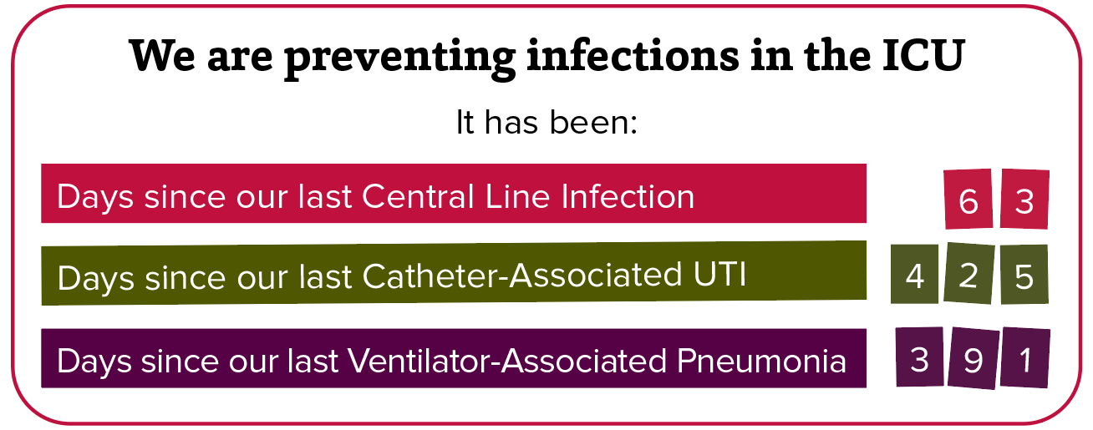
Make information easy to find
Post information prominently in well-trafficked staff areas (e.g., break rooms, nursing stations).
Minimize “clicks” to navigate to electronic information.
Example of a “days since” poster in an ICU

Slide 28
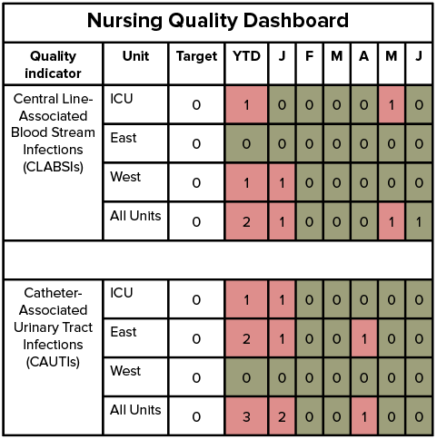
Make information easy to understand
Present counts, percentages, or simple rates, rather than ratios or other complicated measures.
Use colors to denote high performance (e.g., green) vs. low performance (e.g., red) on scorecards, bulletin boards, or newsletters.
Use charts or graphs to show change in performance over time.
Use visuals to relate measures and metrics to goals.
Example of infection counts presented in a quality dashboard

Slide 29
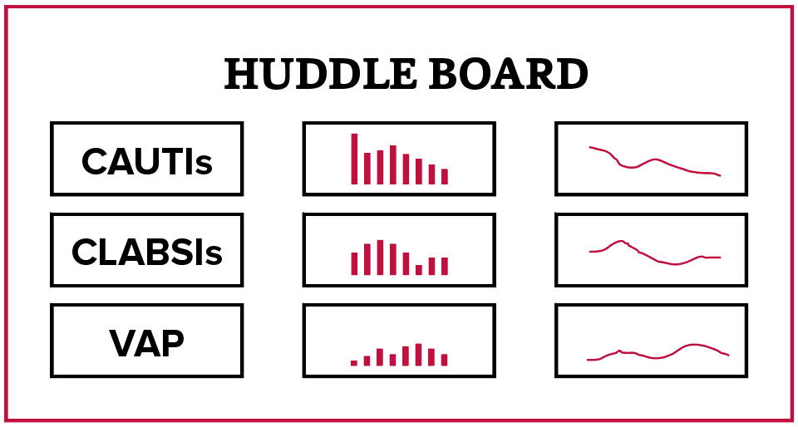
Choose approaches that maintain focus on infection prevention
Circulate HAI information by multiple means to reach all staff members (e.g., email, postings, and in-person discussions).
Utilize huddles or rounding to discuss HAI information daily.
Use other means of communication to direct and support daily discussions (e.g., bulletin boards, dashboards).
Example of HAI information displayed on a huddle board

Slide 30
Determining the frequency and timing of communicating HAI information

Slide 31
The importance of the frequency and timing of communicating HAI information
The frequency and timing of communicating HAI information is important to keep frontline staff focused on infection prevention, to support timely reactions to infections, and to encourage real-time adjustment of infection prevention practices to prevent HAIs in the future.
Different approaches to sharing HAI information may be suited to different communication frequencies:
Daily
Weekly
Monthly

Slide 32
Considerations for the frequency and timing of communicating HAI information
When considering the frequency and timing of communicating HAI information to frontline staff:
Update frontline staff daily with information to maintain engagement and motivation
Notify frontline staff about new infections as soon as possible
Provide timely feedback that can impact infection prevention practices in real time

Slide 33

Update frontline staff daily with information to maintain engagement and motivation
Sharing HAI information on a daily basis demonstrates that infection prevention is a priority.
Consistently sharing HAI information at daily huddles or during rounds can help maintain focus on infection prevention practices.
No new infections to report today. Don’t forget to assess your patients’ Foley catheters and central lines for removal before the end of your shift.

Slide 34

Notify frontline staff about new infections as soon as possible
Promptly informing frontline staff about new infections is critical to support reflection and enable quick action to improve infection prevention practices.
Identifying infections by recognizing the patient and their circumstances, rather than as a statistic, can help emphasize the importance of infection prevention efforts.
Yesterday, we received confirmation that Mr. Smith developed a CLABSI. This means his hospital stay will be extended as we treat his infection. We will be meeting later today to do a deep dive into his care to identify what may have contributed to this infection. We’ll follow up later this week to review any identified gaps in clinical practice.

Slide 35

Provide timely feedback that can impact infection prevention practices in real time
Regularly updated HAI information can inform adjustments to improve infection prevention efforts.
Sharing this information frequently allows frontline staff to adjust their work practices when areas for improvement are identified.
This week’s audit report shows a decrease in our adherence to Foley catheter maintenance. What challenges have people experienced completing their Foley care in the past week that we can address to improve Foley care in the next week?

Slide 36
Maximizing the impact of communicating HAI information

Slide 37
Maximizing the positive impact of communicating information
To maximize the positive impact of communicating HAI information to frontline staff on infection prevention efforts, communicators should:
Maintain focus on infection prevention efforts
Identify areas for improvement in infection prevention practices
Motivate staff and celebrate their successes
Spread best practices identified through reporting of measures and metrics

Slide 38

Maintain focus on infection prevention efforts
Promote ownership of HAI measures and metrics and accountability for infection prevention.
Provide HAI information at the unit and individual level to help convey that everyone’s actions impact HAI prevention.
Promote accountability by being transparent about HAI information.
Share and discuss HAI information regularly to keep infection prevention a priority.
Make reporting and discussing HAI information a part of the routine in daily huddles and/or rounding.

Slide 39

Identify areas for improvement in infection prevention practices
Provide feedback about adherence to infection prevention practices.
Use HAI information to find where improvements to infection prevention practices can be made and guide actions to address adherence.
Investigate infections to identify gaps in infection prevention practices.
Use the identification of a new HAI as an opportunity to reflect on the care that patient received.

Slide 40

Motivate staff and celebrate their successes
Compare HAI measures and metrics to HAI reduction goals.
Provide visual reminders of goals in relation to current metrics and measures.
Celebrate success with rewards and recognition.
Give rewards, such as a trophy or party, when infection prevention milestones are achieved.
Provide recognition in meetings or emails for exemplary infection prevention practices of individuals or units.

Slide 41

Spread best practices identified through reporting of measures and metrics
Identify successful units or individuals and share their strategies to improve infection prevention practices.
Use HAI information to identify units and individuals with success in infection prevention.
Use these units and individuals as examples for others and as a resource for strategies to successfully prevent infections.

Slide 42
Summary
Meaningful communication of HAI information can inform and empower frontline staff in their efforts to prevent infections.
Consider these aspects of sharing HAI information:
Choosing measures and metrics
Selecting ways to communicate HAI information
Determining frequency and timing of communication
Look for opportunities to maximize the impact of communicating HAI information to support infection prevention practices at your hospital

Slide 43
The key takeaway is ...
Maximize the impact of HAI communications to frontline staff by using metrics and measures that are meaningful to them and be sure to celebrate successes.

Slide 44
Closing information
The research and development of this toolkit were funded by the Agency for Healthcare Research and Quality [Grant# R01HS024958].
If you would like further information about this study, or would like to participate in future research studies, please contact the SMART Principal Investigator, Dr. Ann McAlearney, at ann.mcalearney@osumc.edu.

